Slide 1
GROTON OLD HOME DAY
2023

Slide 2
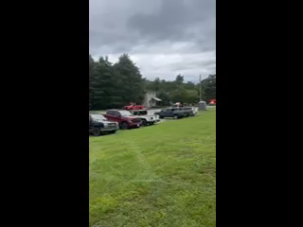
THE PARADE

Slide 3
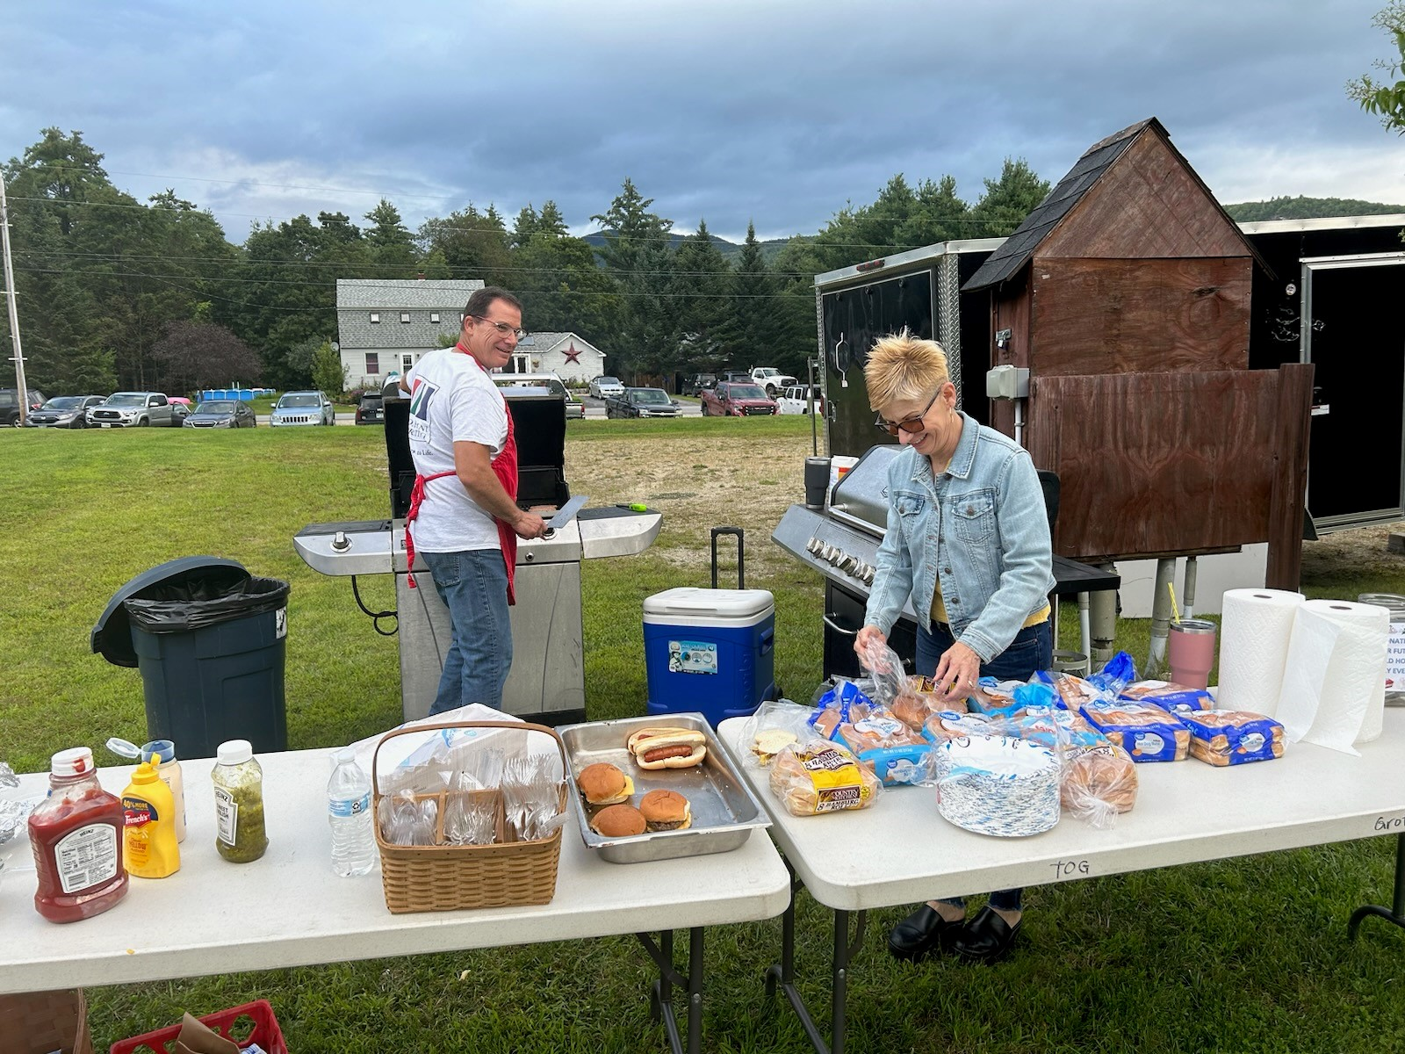
THE COOKS

Slide 4
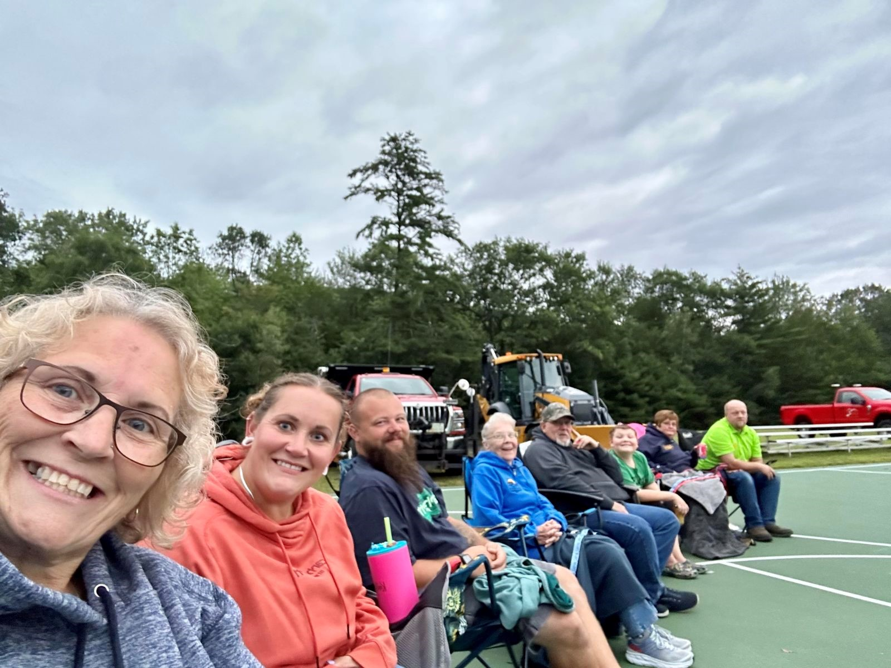
SOME PICTURES FROM THE DAY…

Slide 5
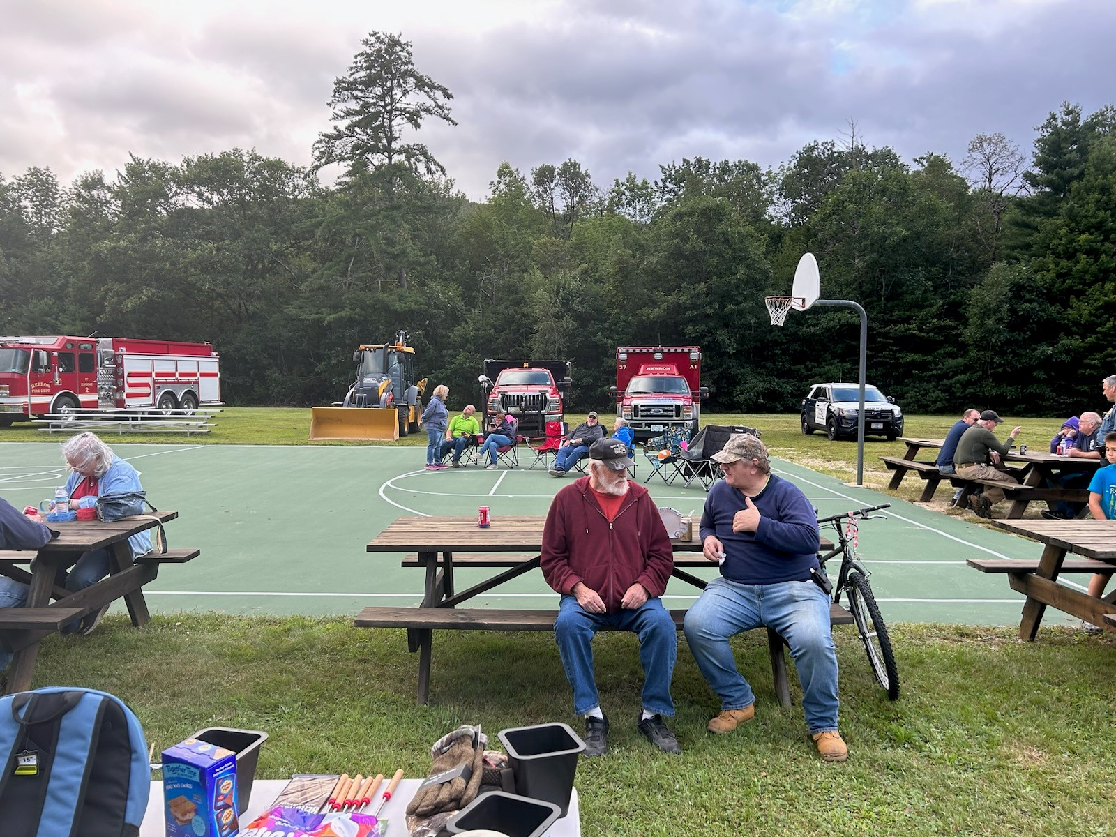
SOME PICTURES FROM THE DAY…

Slide 6
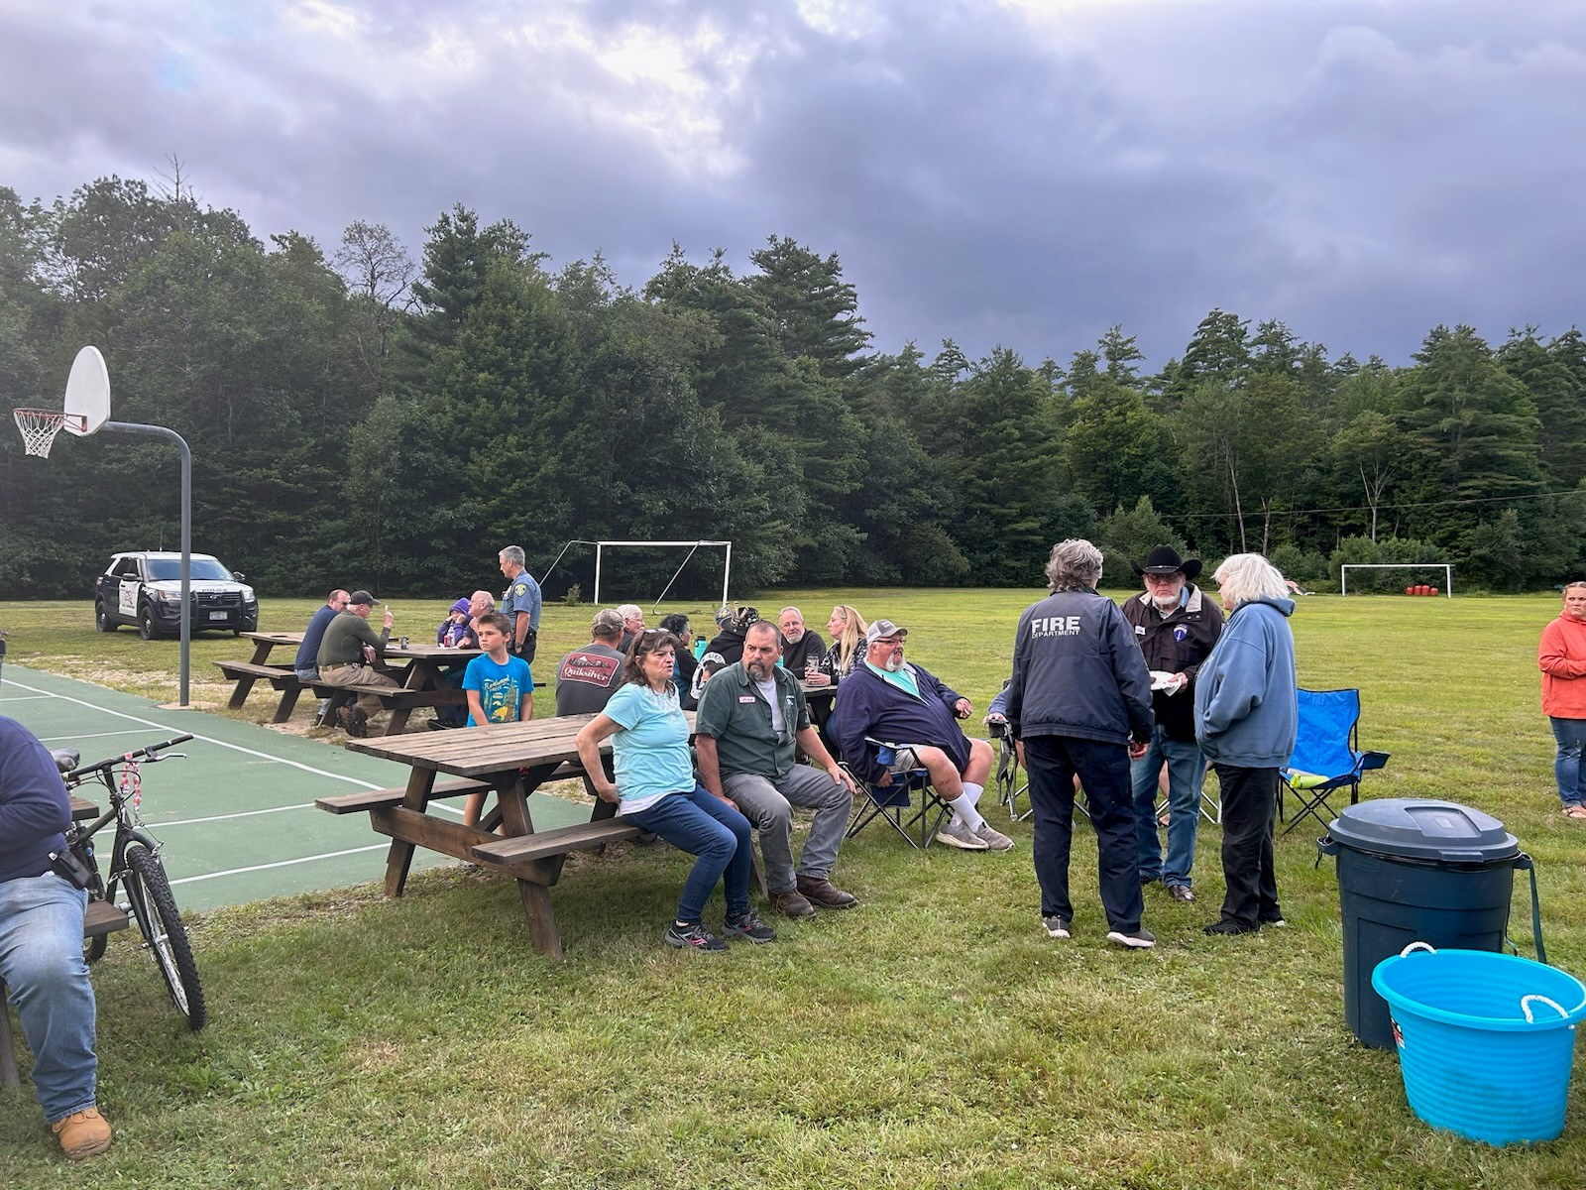
SOME PICTURES FROM THE DAY…

Slide 7
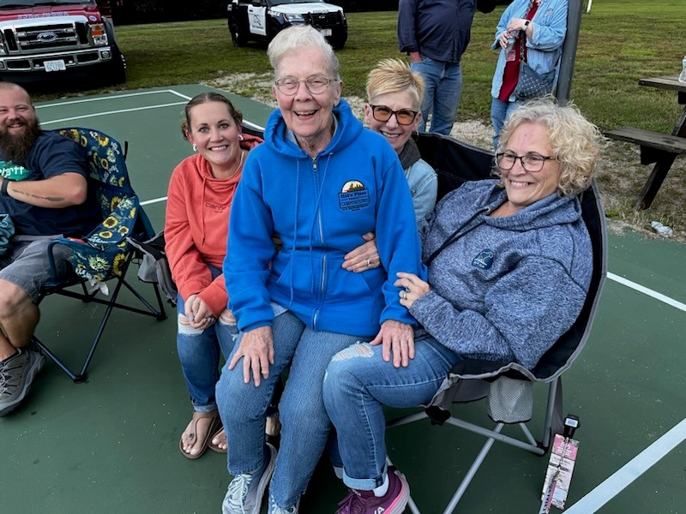
SOME PICTURES FROM THE DAY…

Slide 8
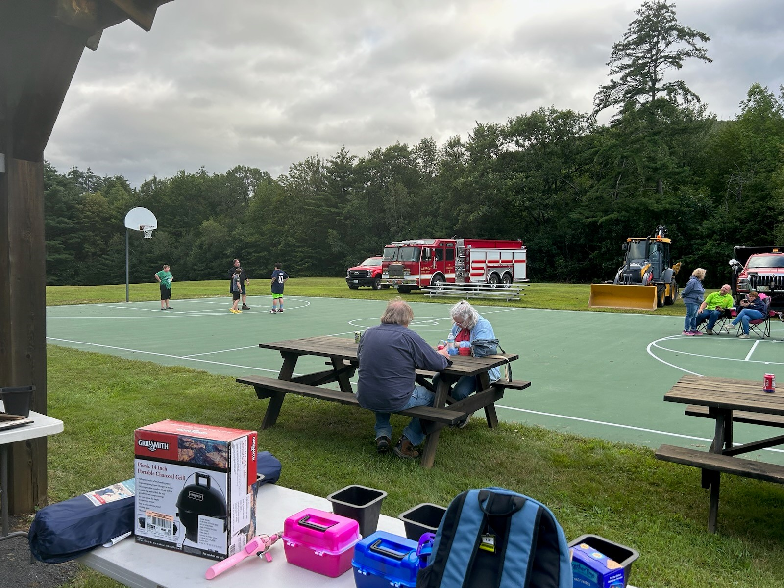
SOME PICTURES FROM THE DAY…

Slide 9
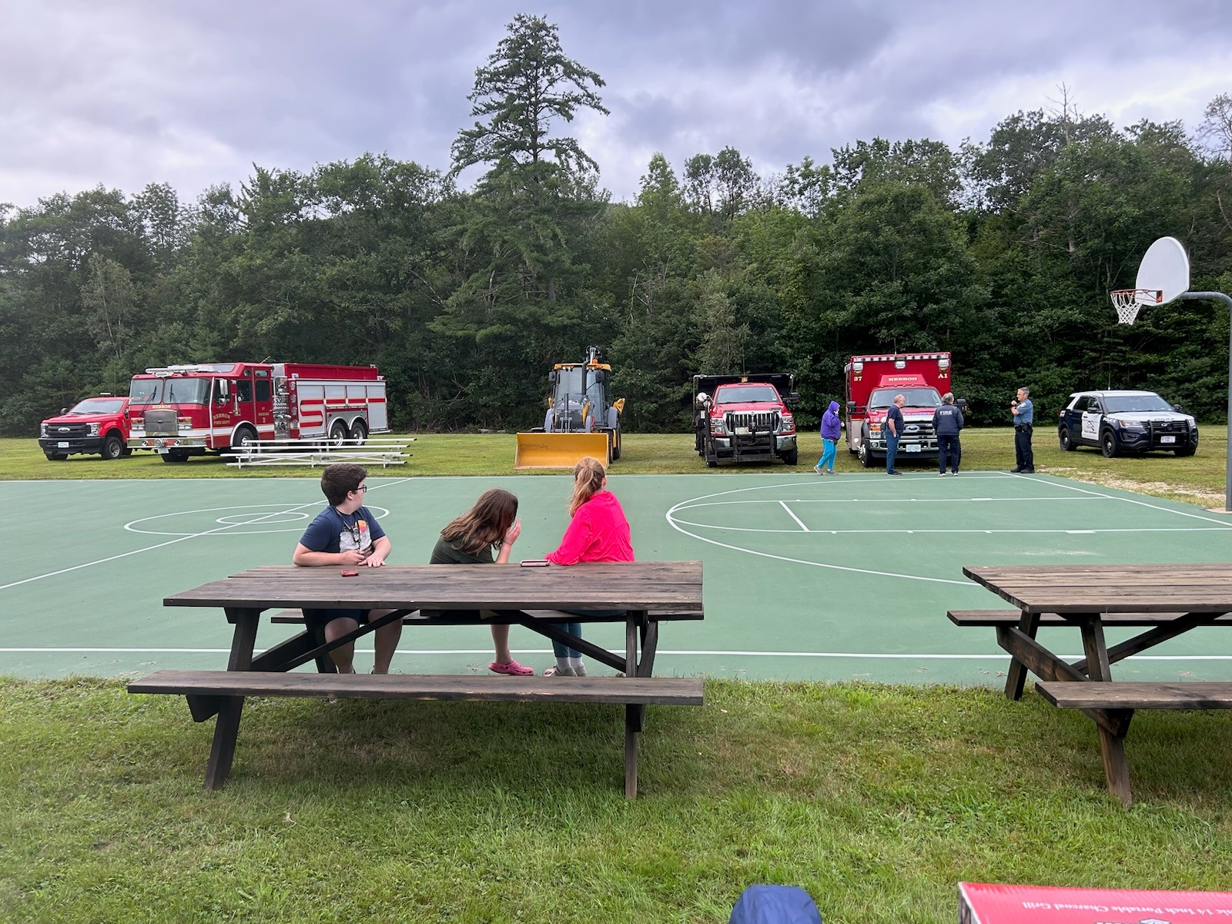
SOME PICTURES FROM THE DAY…

Slide 10
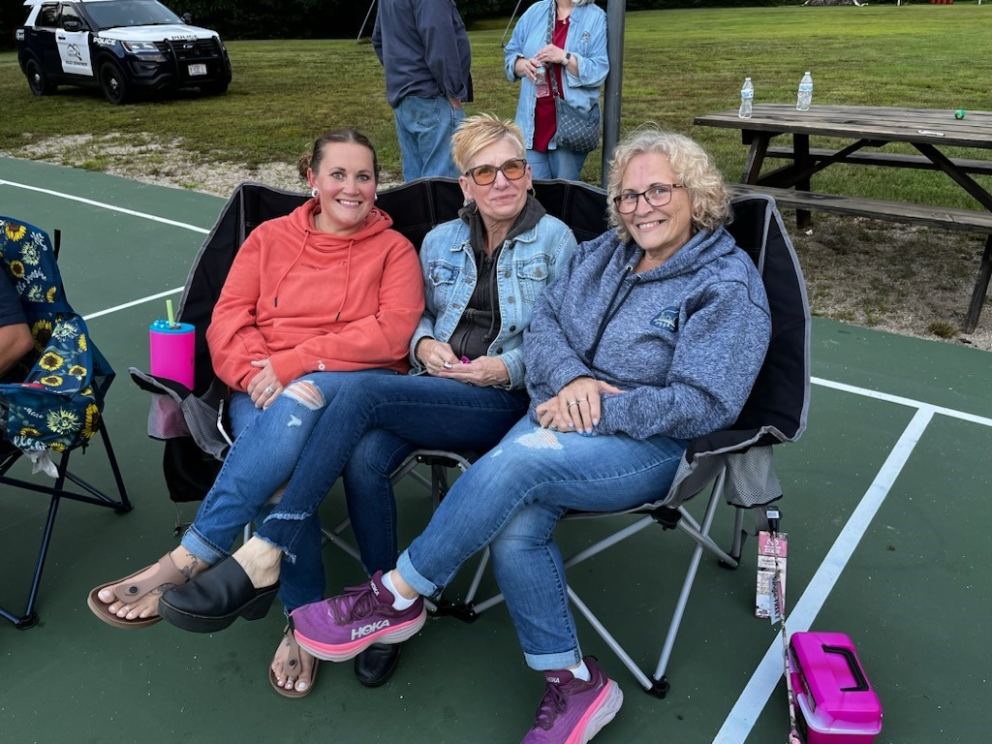
SOME PICTURES FROM THE DAY…

Slide 11
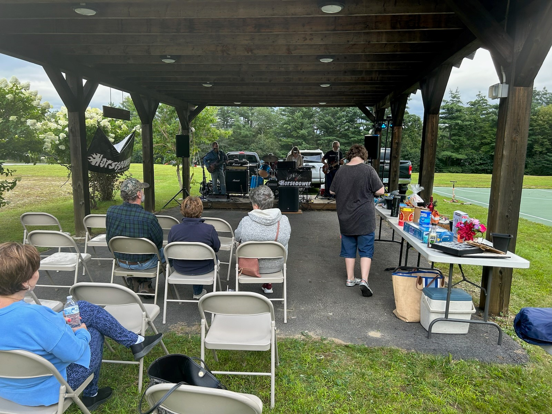
THE BAND
HORSEPOWER!

Slide 12
THANK YOU!!
Thank you to Gina Rescigno for all of her hard work making this event happen every year!
Thank you to the Highway Department for all of the help setting up, taking down, putting signs out and everything else you do to make this event happen!
Thank you to Sara Smith for all of her help behind the scenes to make this event happen!
Thank you to John and Gina for all of their help, for cooking that day and for all of the other food you made and provided!
Thank you to Janet Wallace and Robert Ellis for their help and their donations of food and items for the raffle!
Thank you to Suzanne’s Pastries for making dessert and for donating a cake for the raffle!
Thank you to everyone who attended, those who took part in the parade, to anyone else that may have donated food or items for the raffle and to those that took pictures of the fun!!

Slide 13

Thank you to Avangrid for your continued support to the Town and making this event possible every year!!

