Slide 1
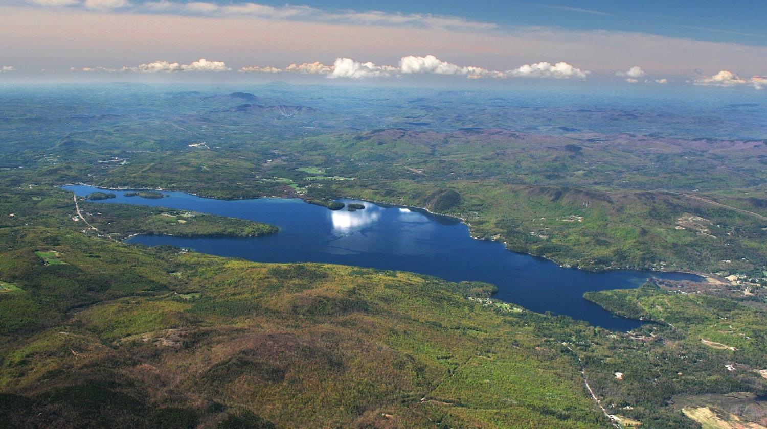


Land Conservation Priorities
In the Newfound Lake Watershed
January 23, 2015
Dan Sundquist
GreenFire GIS
Every Acre Counts
The Newfound Watershed Master Plan

Slide 2
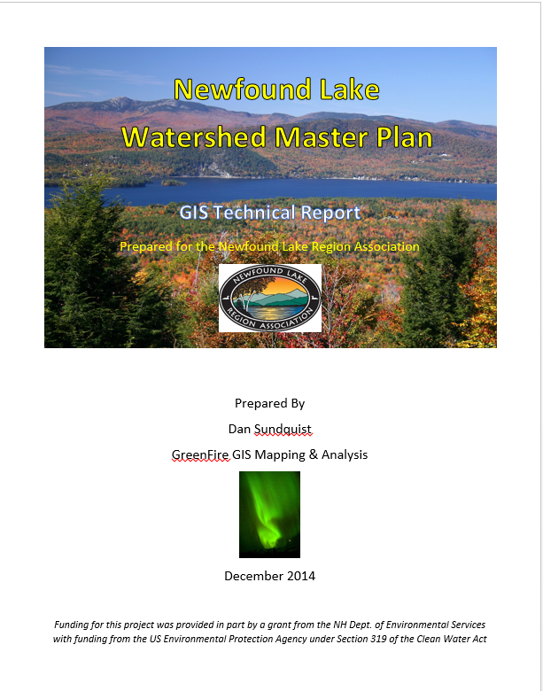

Slide 3
Conservation Planning Process
Map Key Natural Resource Features
Generate a Co-occurrence Map of All Features
Analyze Co-Occurrence Map for
High-Value Areas
Caveats:
Best-Available Public GIS Data
Scaling Issues (Regional v. Site Scale)
Refine the Plan?

Slide 4
Natural Resource Feature Overview
Objective: Protect Natural Resource Features that Maintain and Enhance Water Quality in Newfound Lake and Tributaries
Surface Water Resources
Drinking Water Resources
Steep Slopes & Highly Erodible Soils
Wildlife Habitat
Prime Agricultural Soils & Most Productive Forest Soils

Slide 5
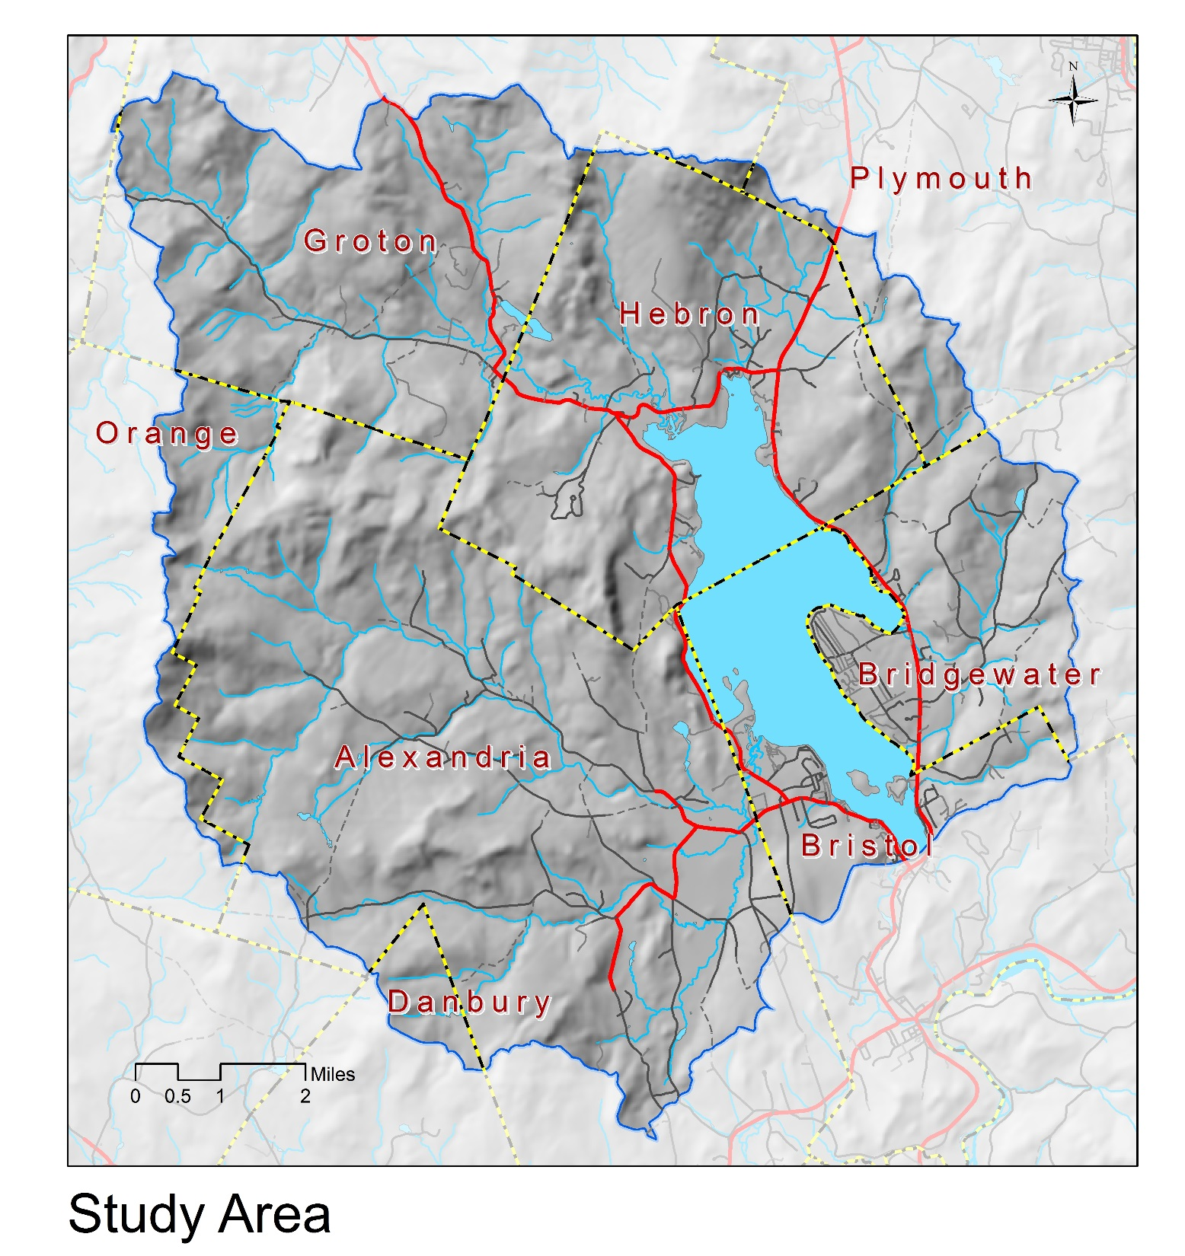
~61,000 Acres or 95 Sq. Miles
56, 326 Acres Land Area

Slide 6
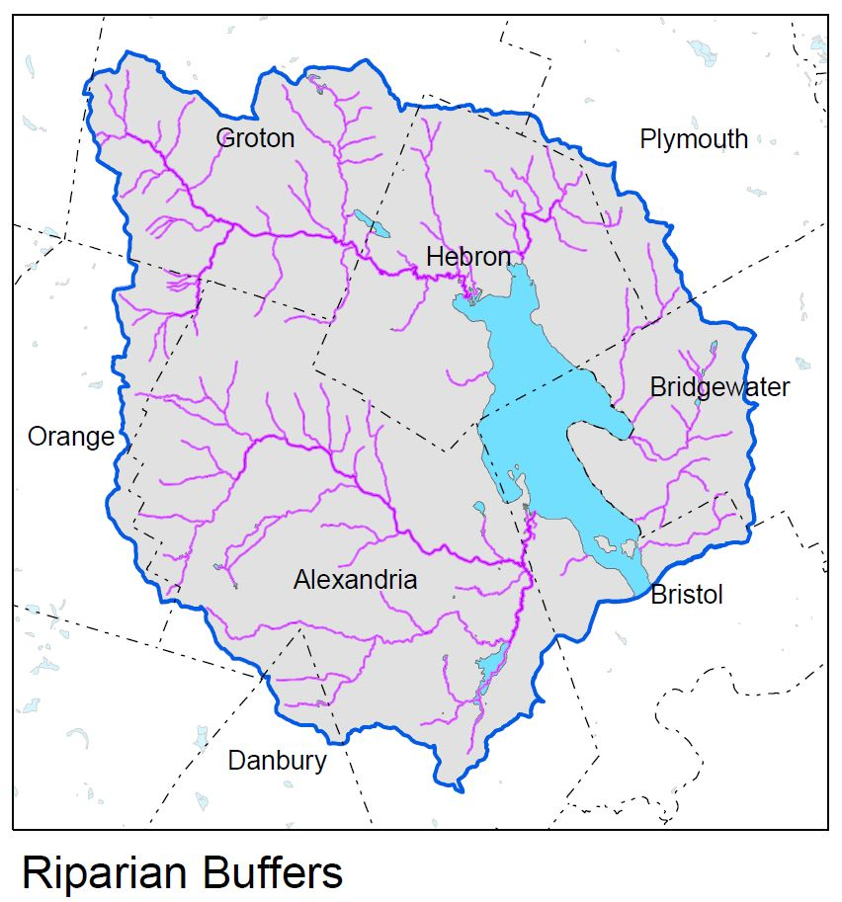

Slide 7
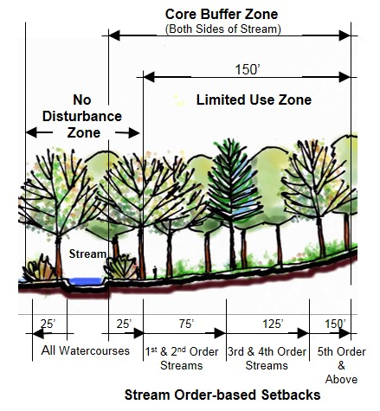

Slide 8
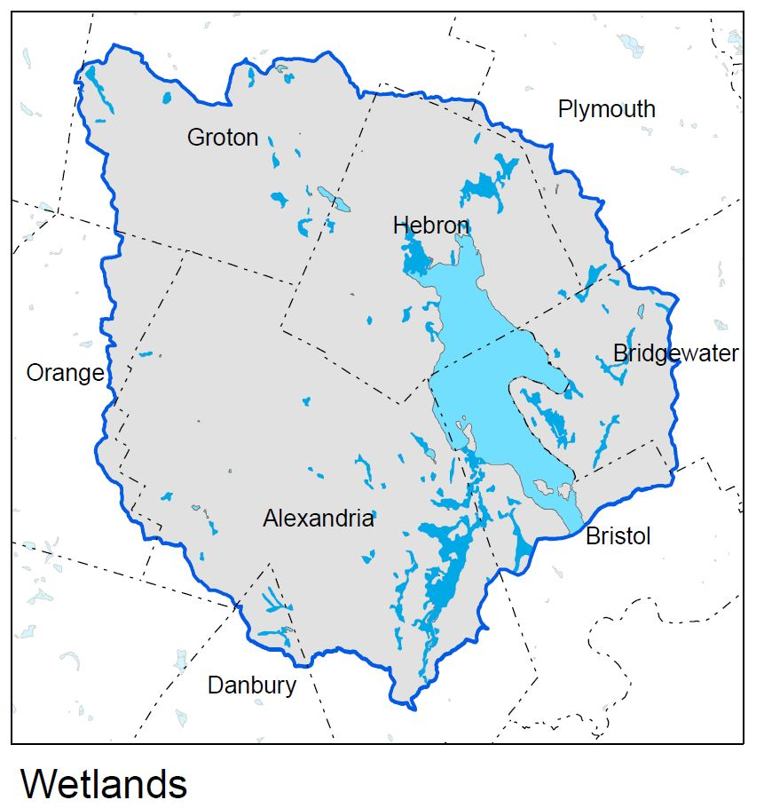

Slide 9
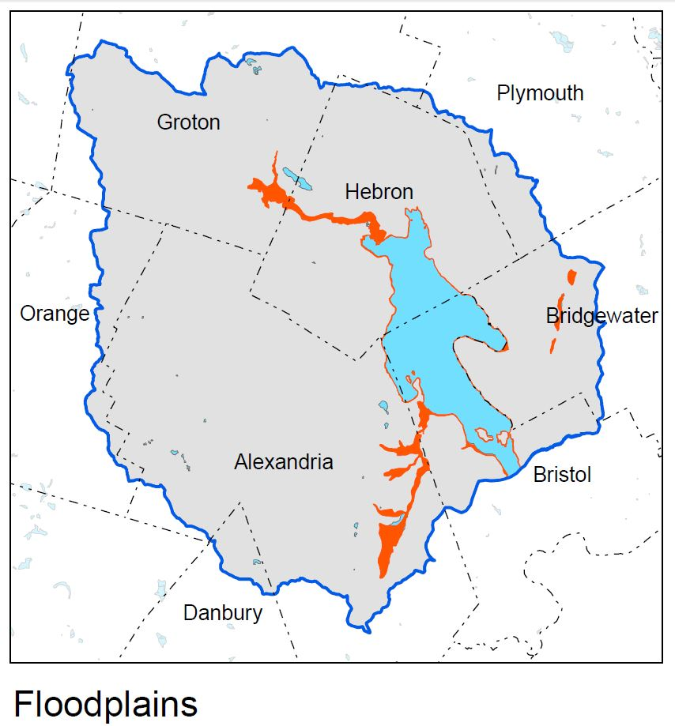

Slide 10
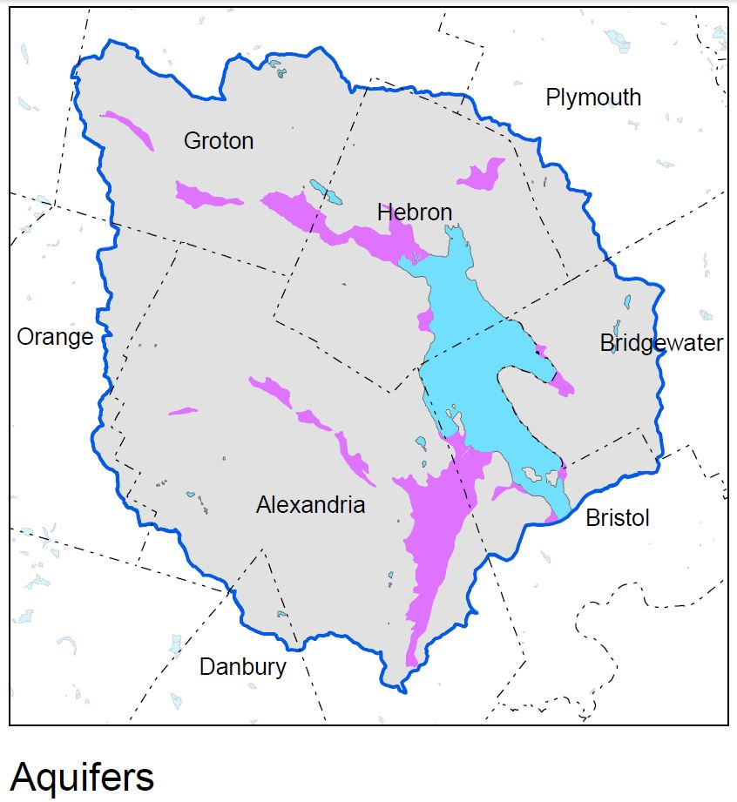

Slide 11
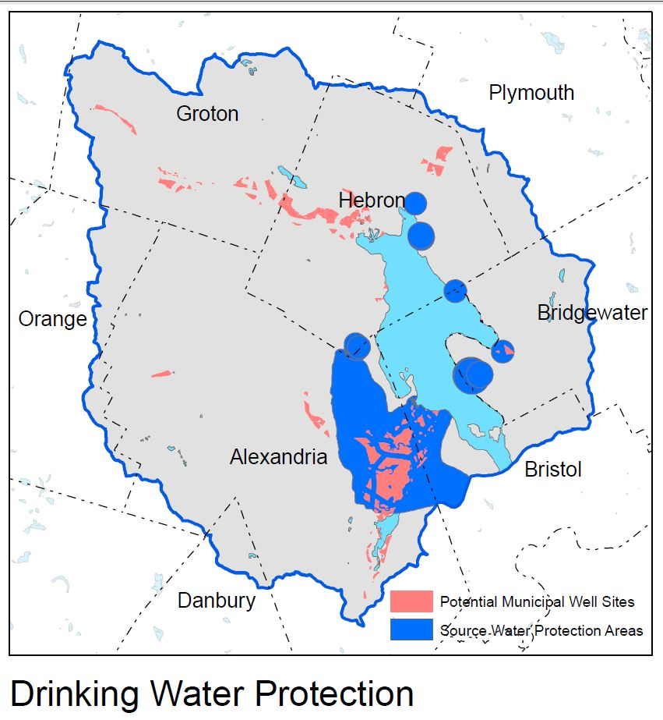

Slide 12
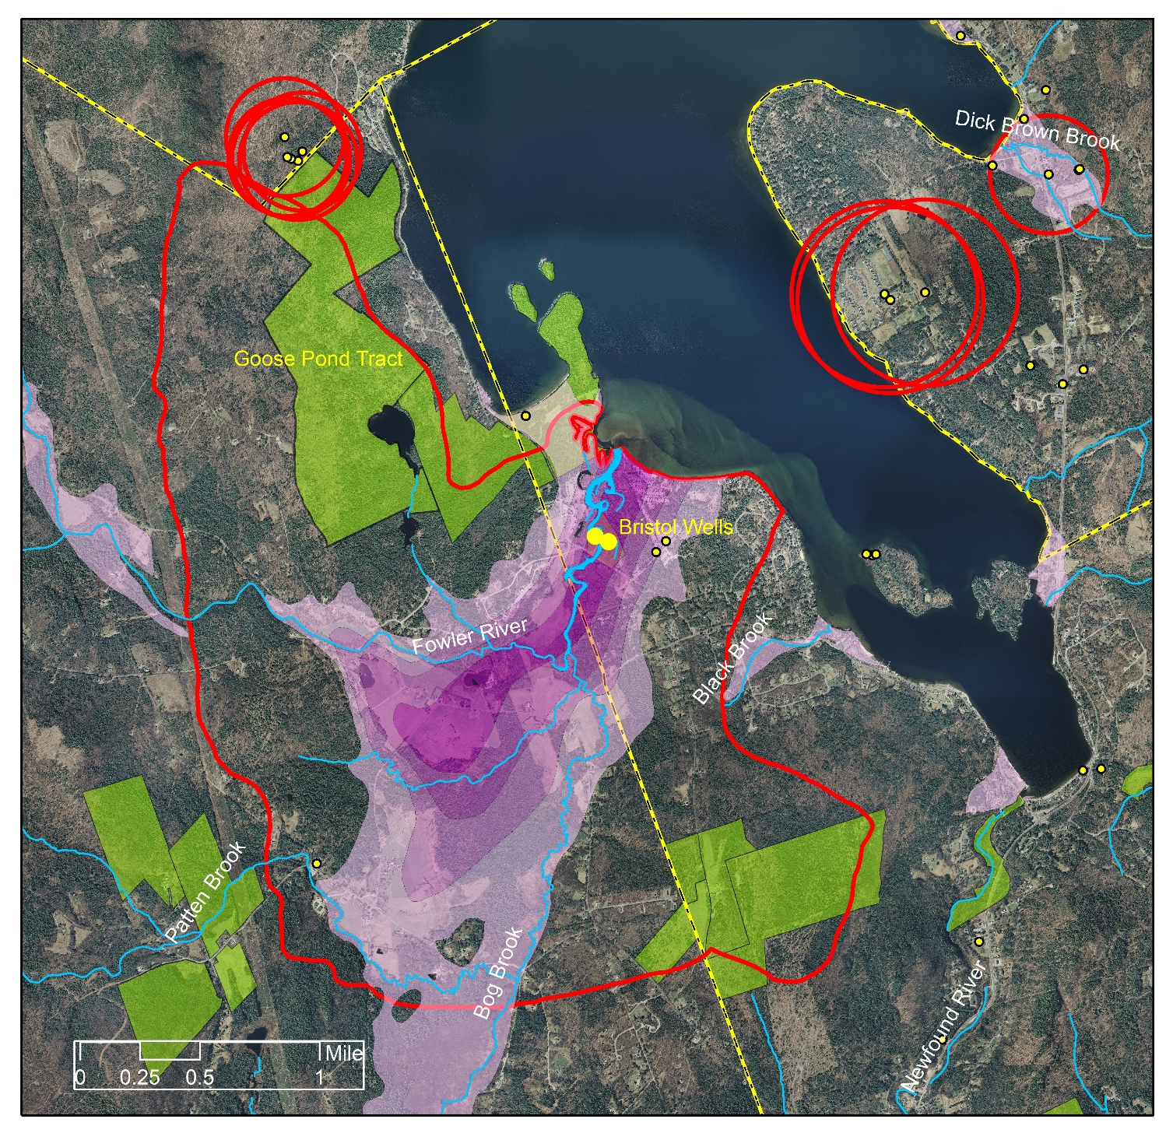

Slide 13
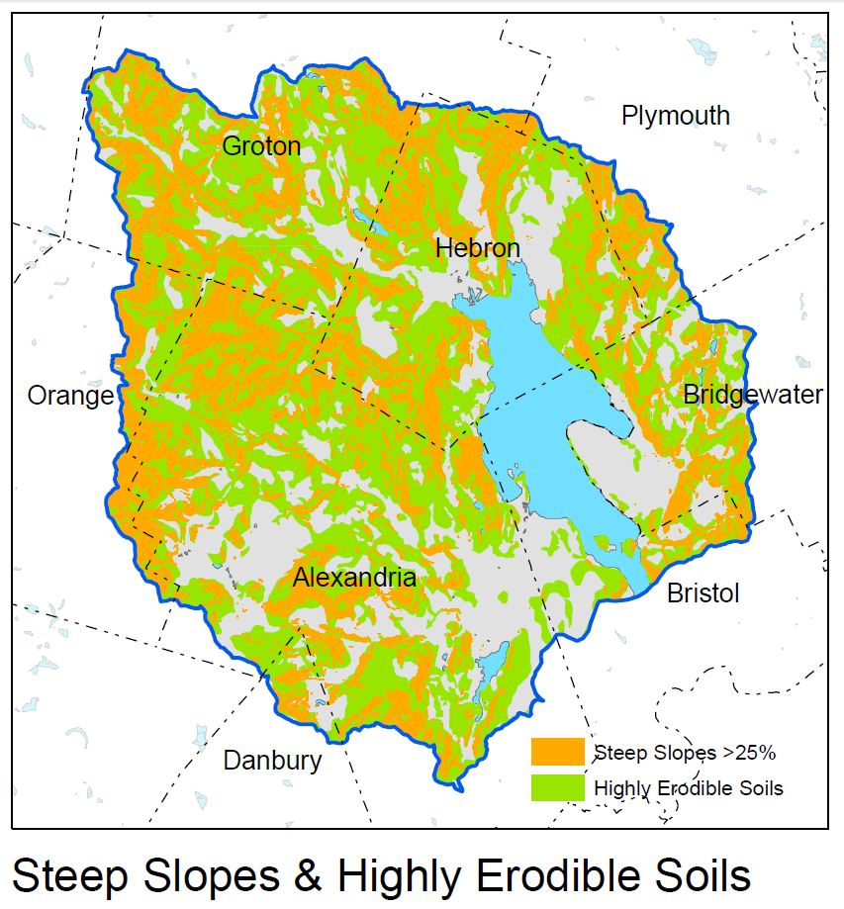
Steep Slopes = 22% Watershed
Erodible Soils = 68% Watershed
21% Watershed = Both Steep
Slopes & Highly Erodible Soils

Slide 14
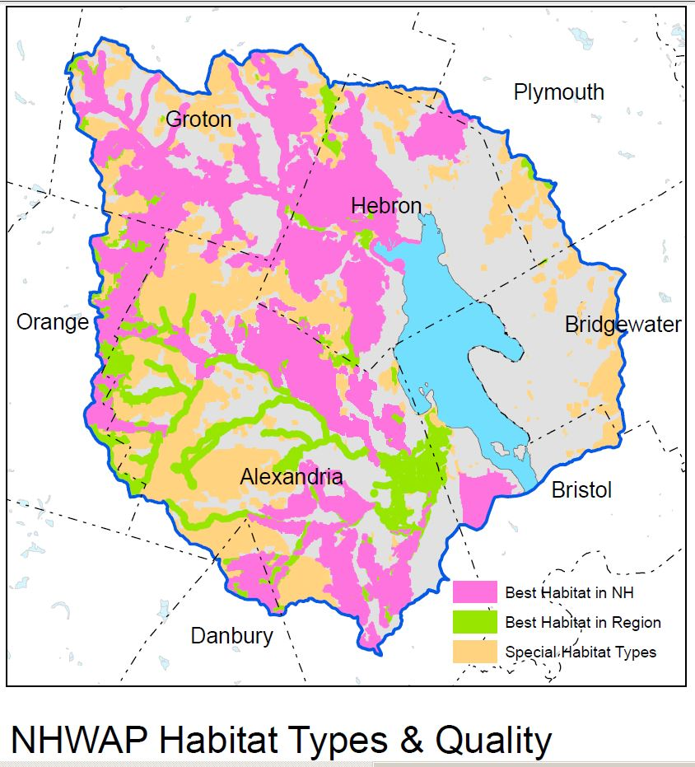

Slide 15
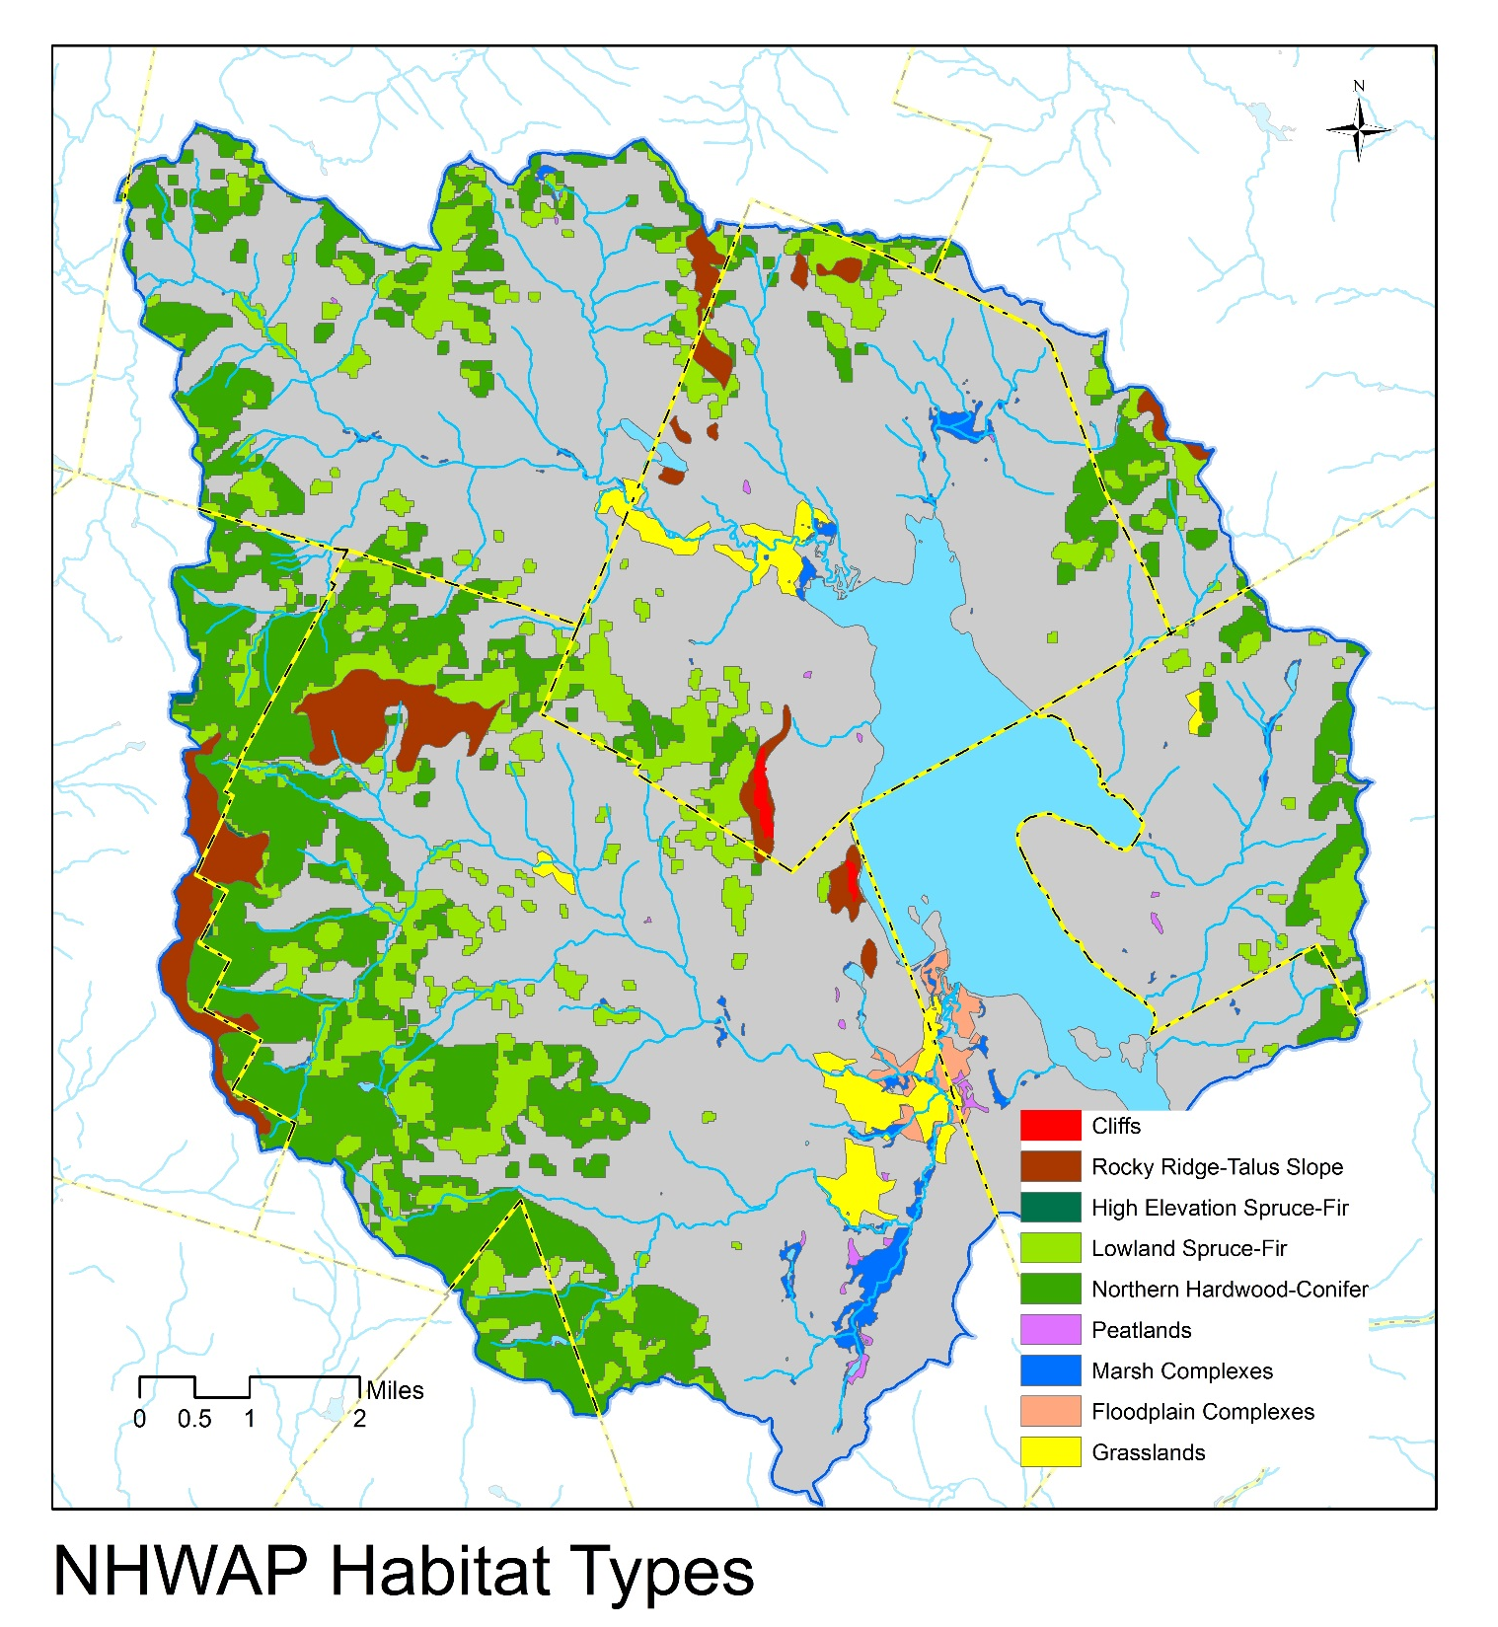

Slide 16
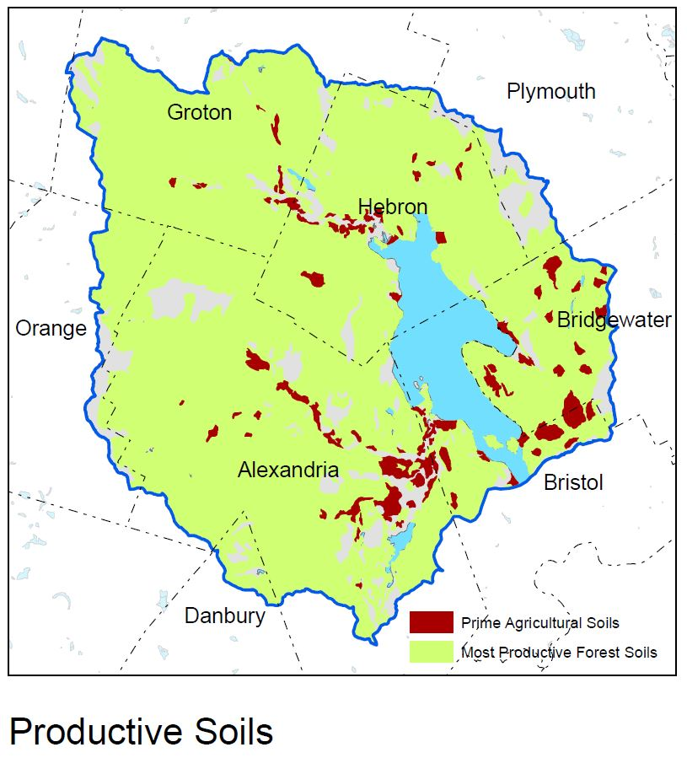

Slide 17
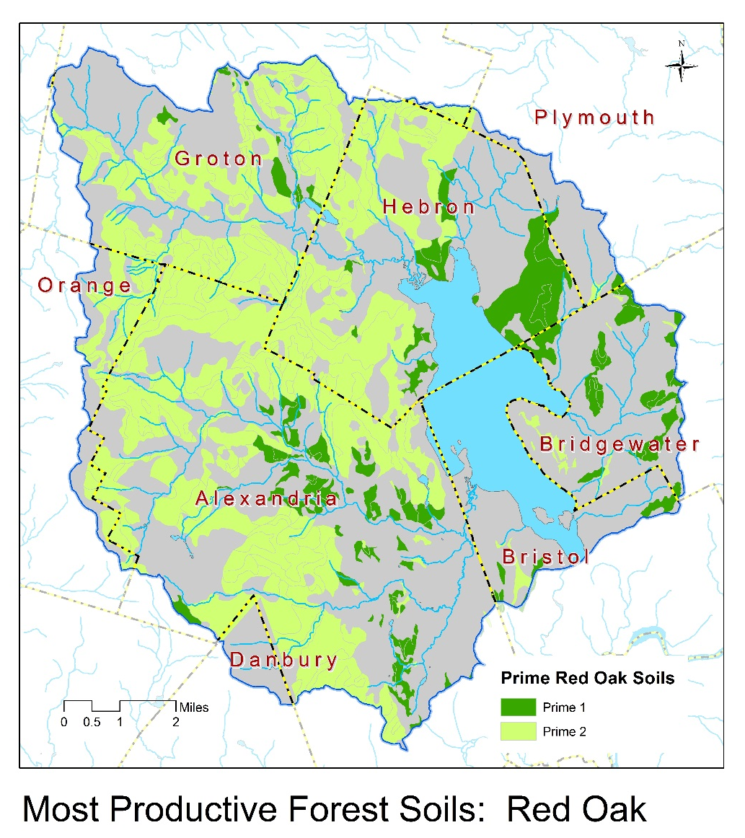
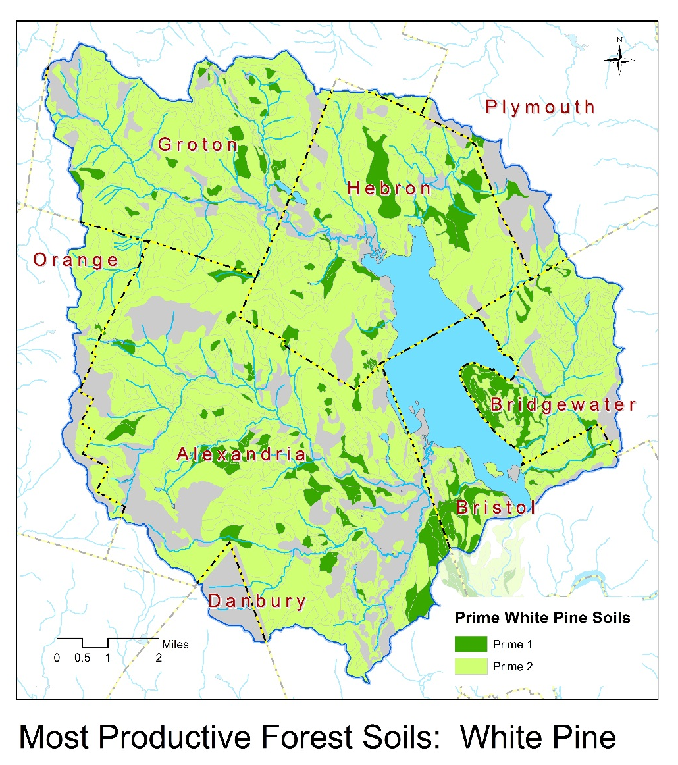

Slide 18
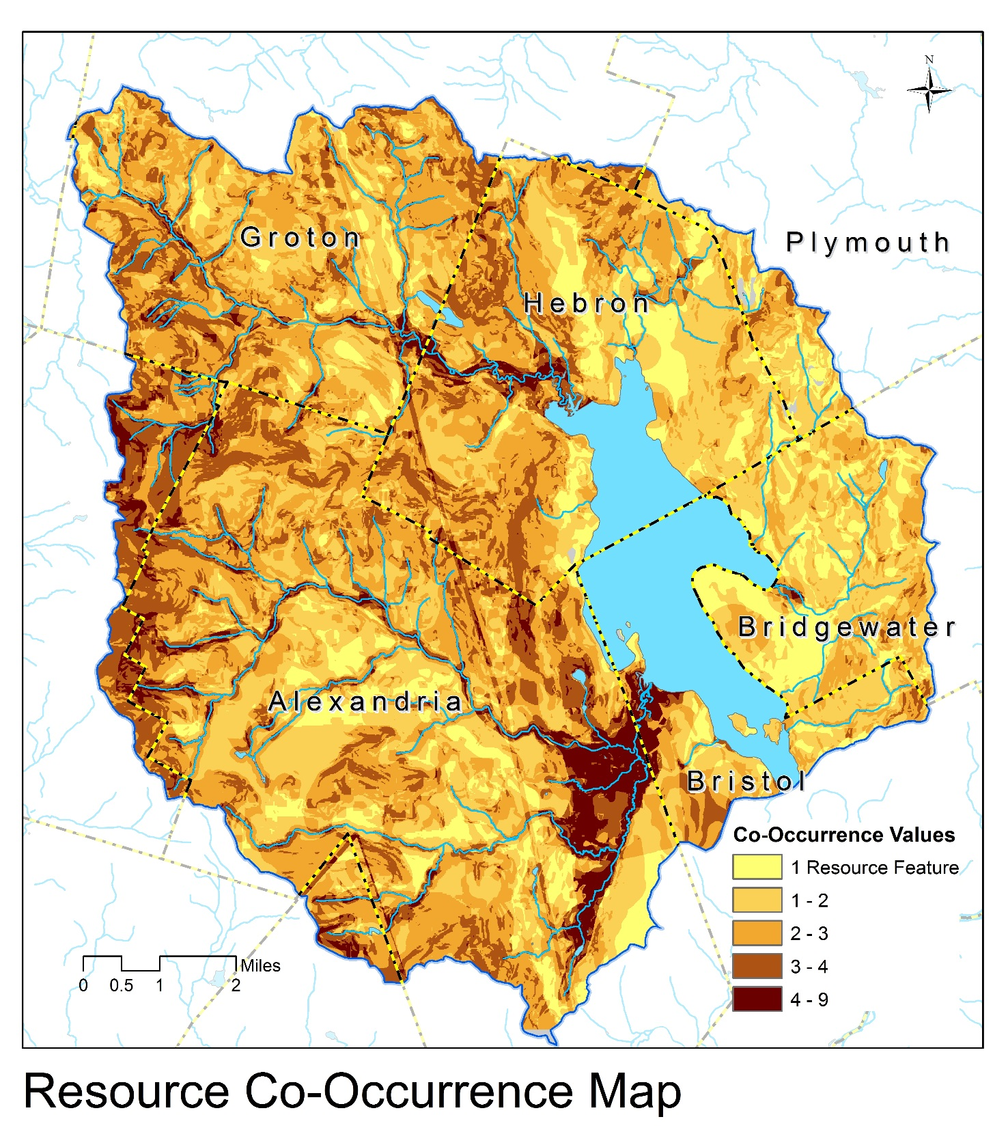

Slide 19
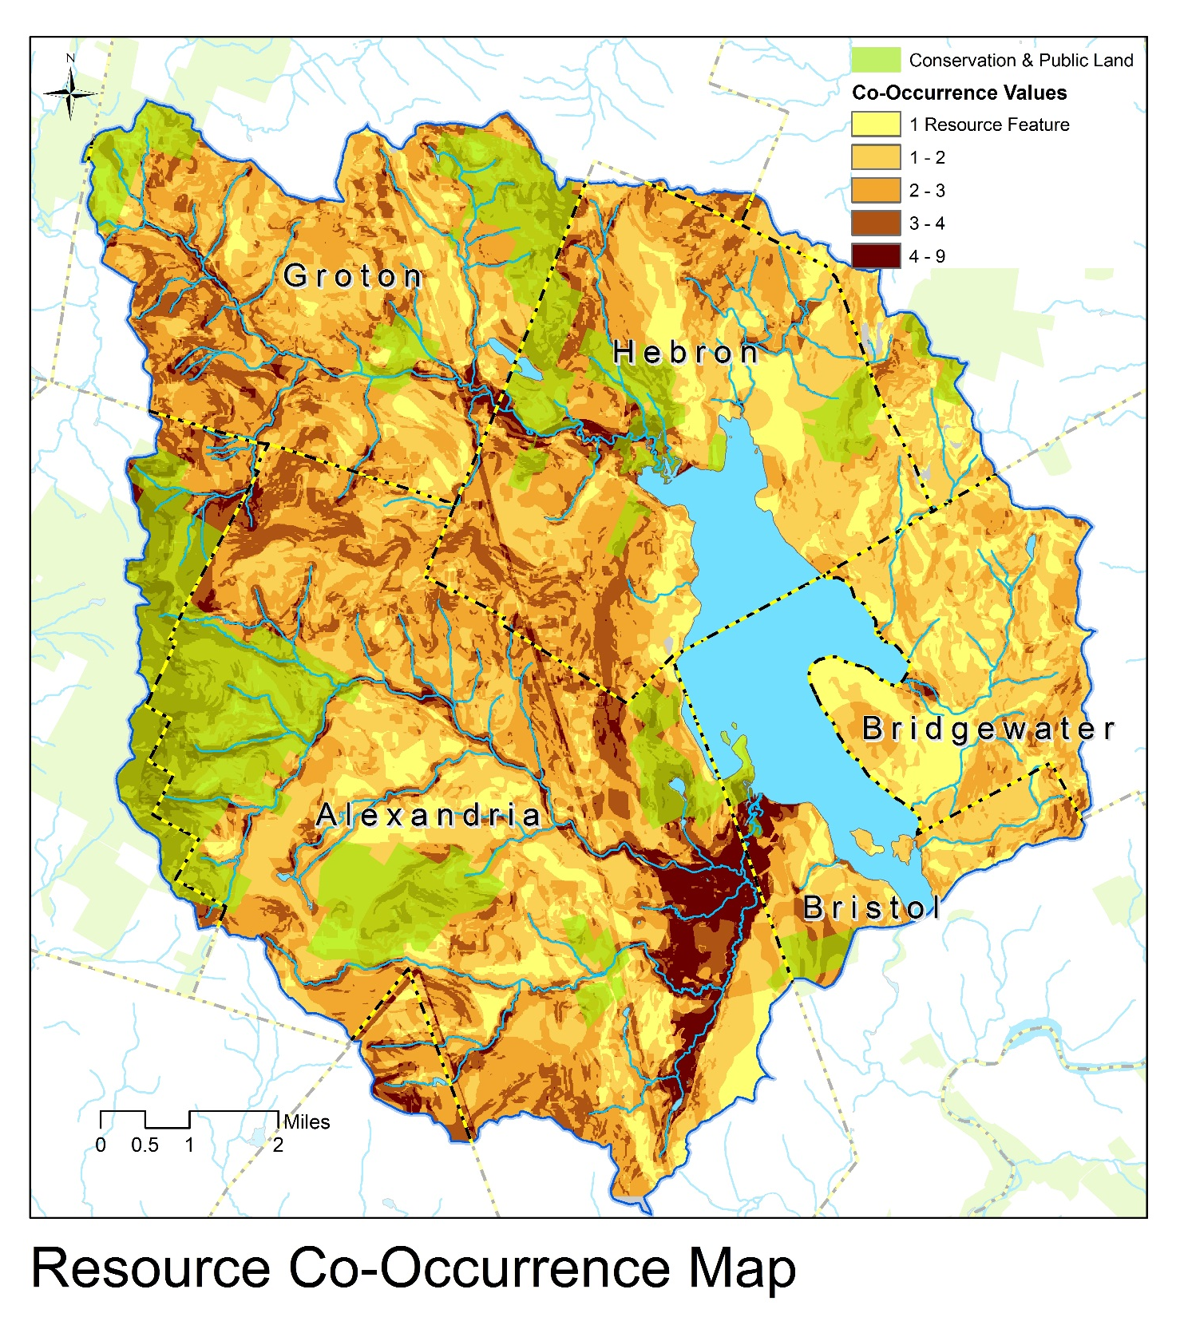
~10,000 Acres Conserved
18% of Land Area

Slide 20
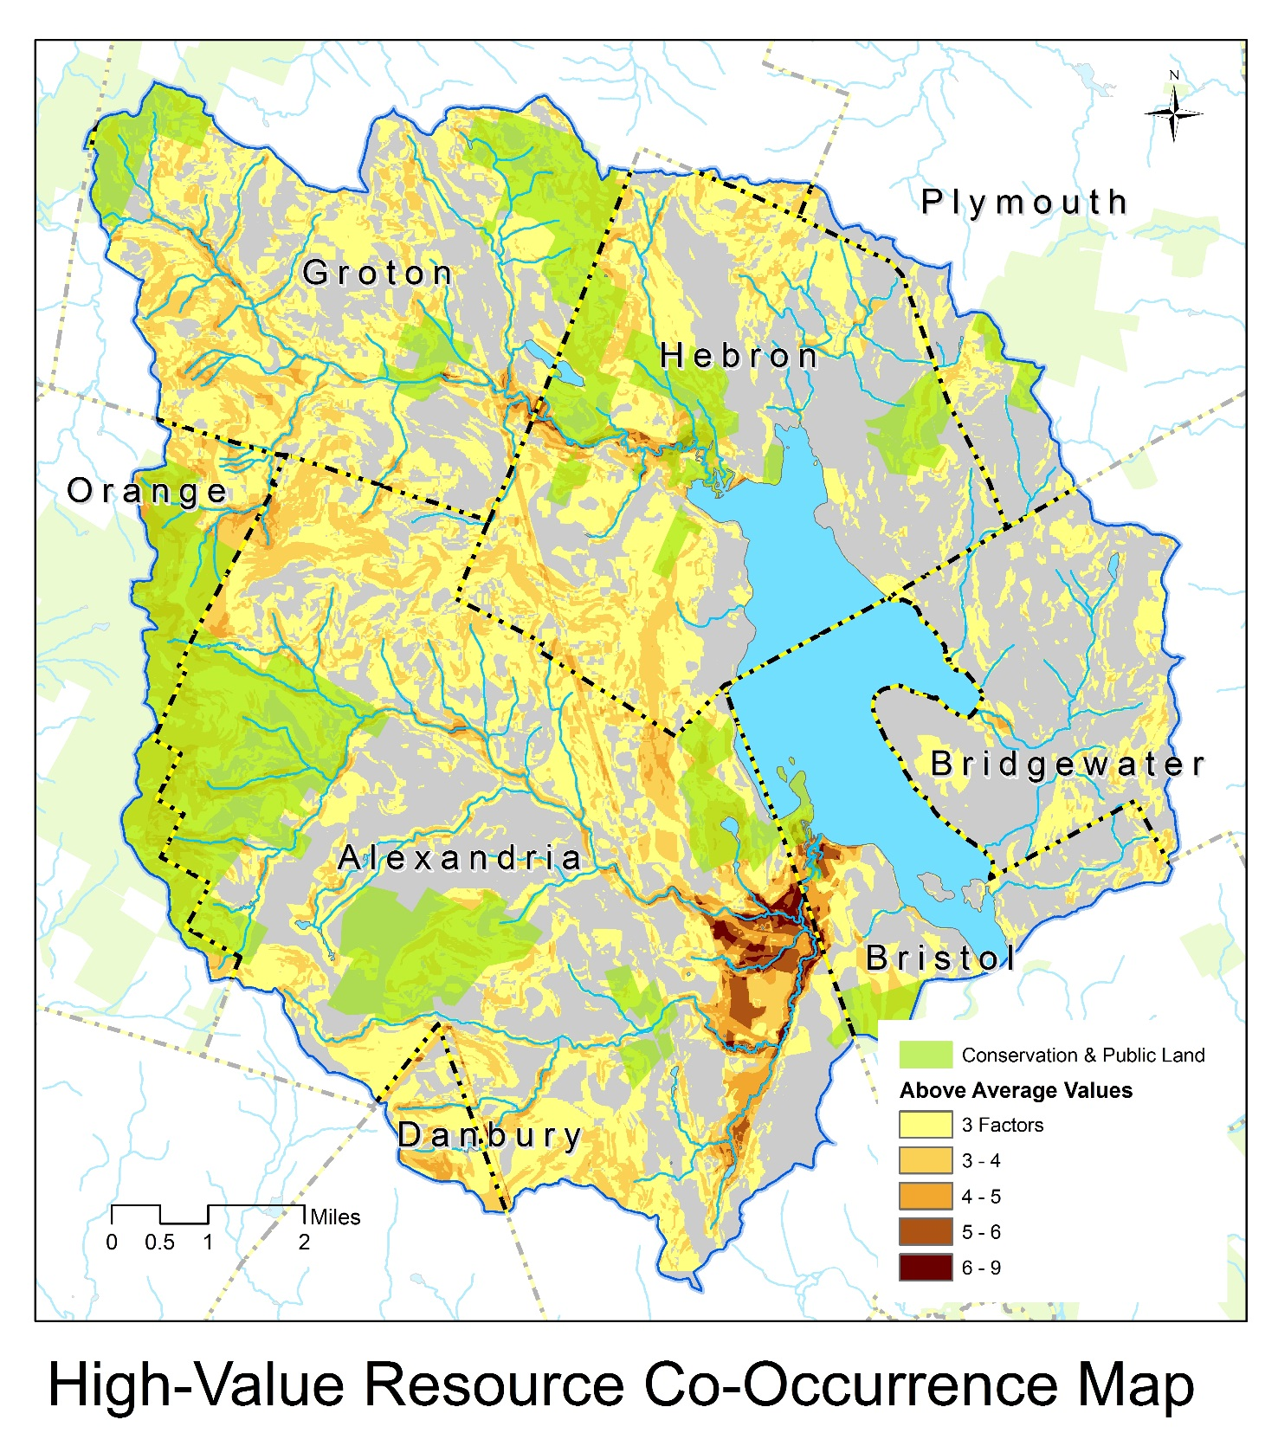
~34,800 Acres Above Average
or 60% Watershed
~7,700 Acres Conserved (22%)

Slide 21
Resource Protection Status

Slide 22
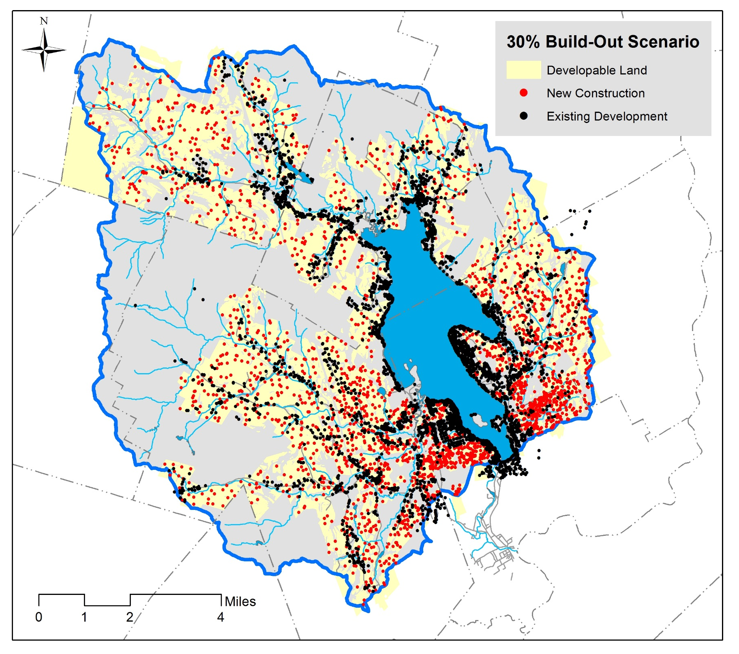

Slide 23
Next Steps…
Confirm Objective: Protect Natural Resource Features that Maintain and Enhance Water Quality in Newfound Lake and Tributaries
Recommended Priority Features to Protect:
Riparian zones along rivers and tributaries
Land surrounding wetlands & floodplains (buffers)
Aquifer recharge zones (especially Fowler River)
Steep slopes & highly erodible soils (headwaters)
Plan Refinement: Consider developing a “shared vision” of conservation priorities with a regional stakeholder group.

Slide 24
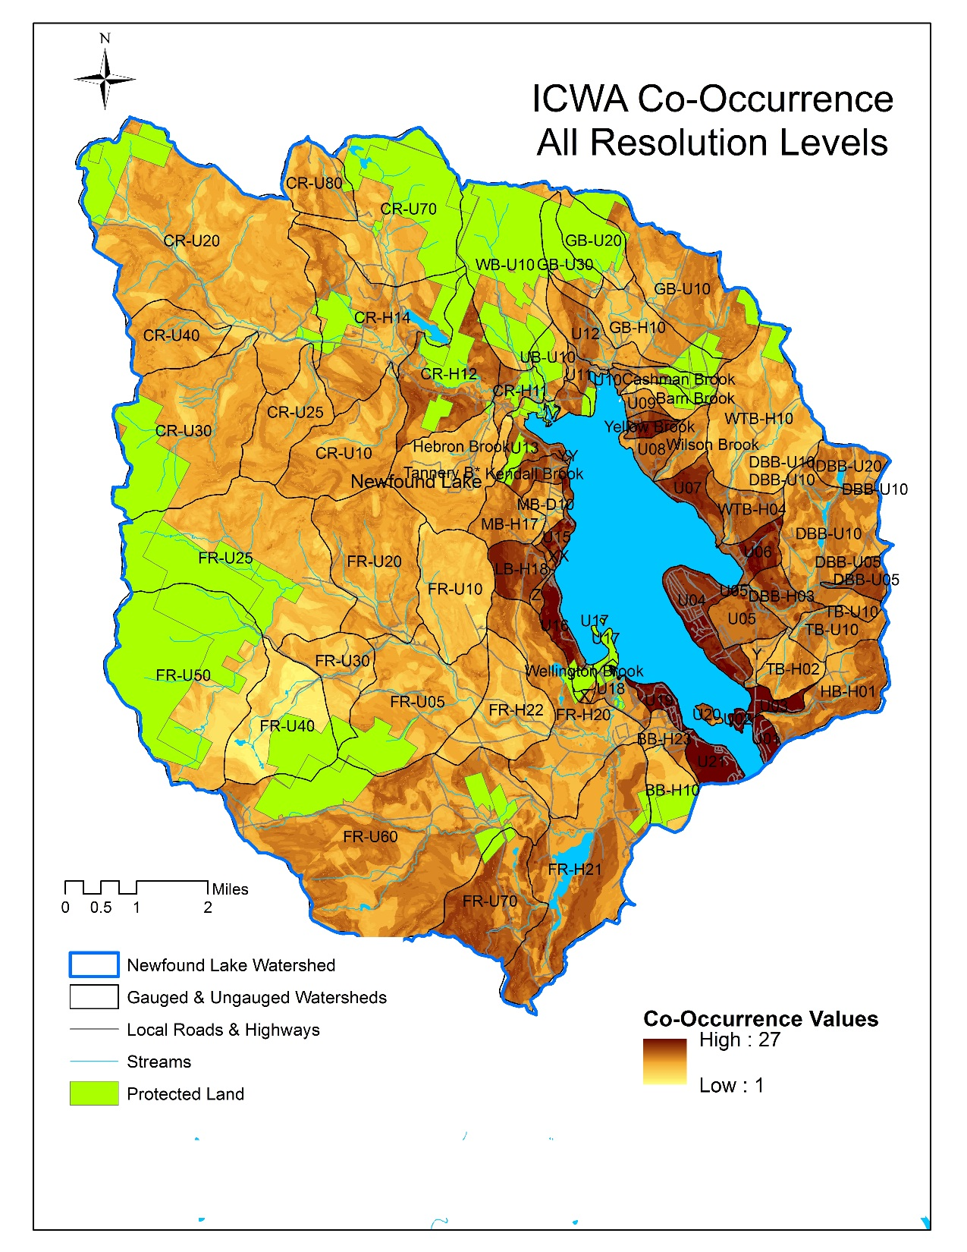
~10,000 Acres Conserved
18% of Land Area

